Slide 1
UNIVERSITY INSTITUTE OF COMPUTING
MASTER OF COMPUTER APPLICATIONS
Design and Analysis of Algorithms
23CAH511
UNIT-3
DISCOVER . LEARN . EMPOWER

Slide 2
SUM OF SUBSETS PROBLEM
This is a simple algorithm, but it demonstrates that sometimes you need to return to a previous state and re-evaluate a previous decision in order to solve a problem.
Backtracking is a general algorithmic technique that considers searching every possible combination in order to solve an optimization problem. Backtracking uses depth-first search approach. By inserting more knowledge of the
problem, the search tree can be pruned to avoid considering cases that don't look promising. While backtracking is useful for hard problems to which we do not know more efficient solutions, it is a poor solution for the everyday problems that other techniques are much better at solving.

Slide 3
Sum of Subsets Using Backtracking
Subset sum problem is to find subset of elements
that are selected from a given set whose sum adds
up to a given number .
Ex: let A be a set
A={5,7,10,12,15,18,20}
and given sum m=35
so we have the following subsets that add
up to 35 are:
{15,20},{18,7,10},{5,10,20}, and
{18,12,5}

Slide 4

Assumption and considerations
:

Slide 5
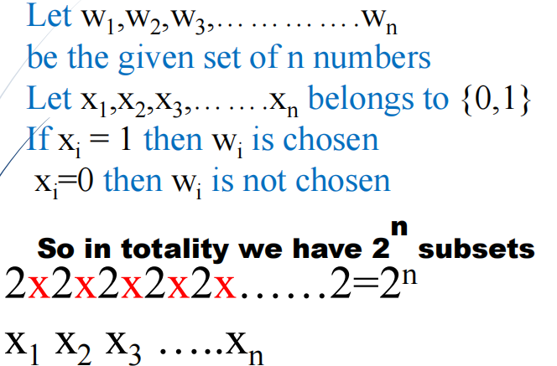
Solution Using NAÏVE APPROACH

Slide 6
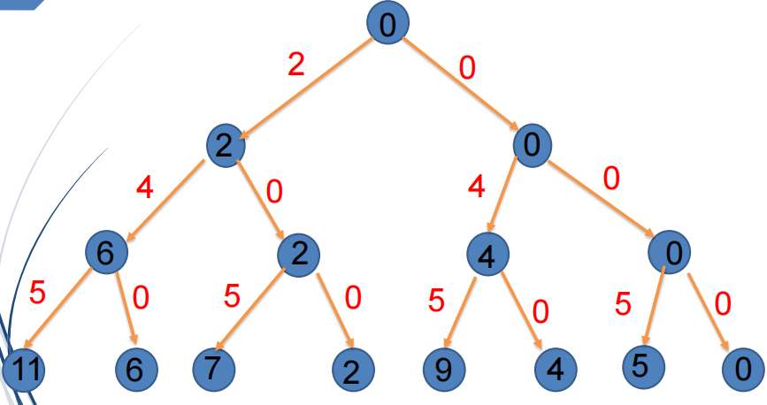
Solution Using NAÏVE APPROACH
A={2,4,5} and m=9

Slide 7
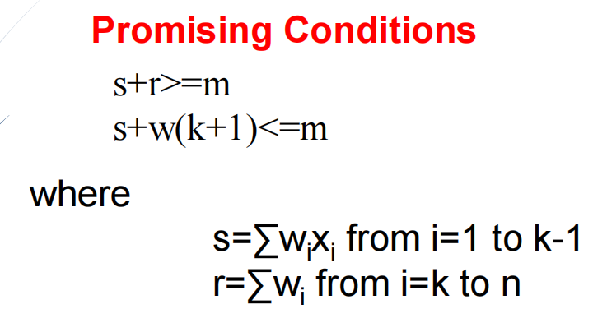
Solution Using BACKTRACKING

Slide 8
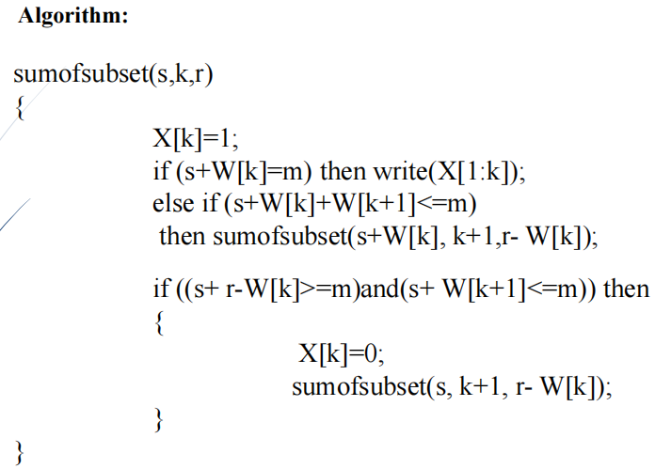
Algorithm

Slide 9
Time Complexity
Complexity Analysis:
Time Complexity: O(sum*n), where sum is the ‘target sum’ and ‘n’ is the size of array.
Auxiliary Space: O(sum*n), as the size of 2-D array is sum*n.

Slide 10
1) https://www.tutorialspoint.com/data_structures_algorithms/divide_and_conquer.htm 2) Data Structures and Algorithms made easy By Narasimha Karumanchi. 3) The Algorithm Design Manual, 2nd Edition by Steven S Skiena 4) Fundamentals of Computer Algorithms - Horowitz and Sahani
References

Slide 11
THANK YOU

